Slide 1
For Live Session Assignment (FLS)
Unit 4

Slide 2
Question 1: Quick Quiz Questions

Slide 3
Question 1
Match the number on the left to the letter on the right.
1. Probability of rejecting Ho when Ho is true. | A. Power
2. The act of failing to reject Ho when Ho is false. | B. The Correct Decision
3. The act of failing to reject Ho when Ho is true. | C. Type II Error
4. The probability of rejecting Ho when Ho is false. | D. Alpha
5. The probability of failing to reject Ho when Ho is false. | E. Beta

Slide 4
Question 2
Which of the following will increase the ability of a test to reject the null hypothesis when the actual value of the parameter is not what is described under the null hypothesis?
Increase Sample Size
Increase Alpha
Increase Effect Size
Increase Sigma
Decrease Sample Size
Decrease Alpha
Decrease Effect Size
Decrease Sigma

Slide 5
Question 3
Given the Education and Income problem in the last FLS, which test listed below will have the most power?
The t-test for detecting the difference in means between the log income for those with 12 years of education and those with 16 years.
Welch’s t-test for detecting a difference in means between the raw income between the 12 and 16 years of educations groups?
Why? Please provide a clear defense of your answer as you would to a client.

Slide 6
End Question 1: Quick Quiz Questions

Slide 7

Question 2 ($≤2$ hours)

Slide 8



Reaction Time Experiment
Let’s assume we have the following test Iet’s also assume it was one sided.):
$$Ho:μ=112$$
$$Ha:μ<112$$
$$α= .05$$
Let’s also say we could afford a sample size of n = 250 and that we have so much domain knowledge about the standard deviation that we will assume $σ=25.$ Answer the following questions and include your R or SAS code.
We know that in reality, the true mean is either 112 or it is not 112. So let’s consider these possibilities!
If the true mean is 112,
1. What is the probability that our test will make a mistake and reject the null hypothesis?
2. What type of error is this called?
If the true mean is 107,
3. What is the effect size?
4. What is the probability that our test will make the correct decision and reject the null hypothesis?.
5. What is the statistical term for this value?
6. Try to draw the test and the alternative distribution, and label all of the above. Please either draw it on paper by hand and paste a snapshot to the slide or construct it digitally. For this one, please don’t screen shot Jeffrey’s app.
Remember! Once a you can draw it, then you know you know it!

Slide 9
End Question 2

Slide 10

Question 3 ($≤2$ hours)

Slide 11
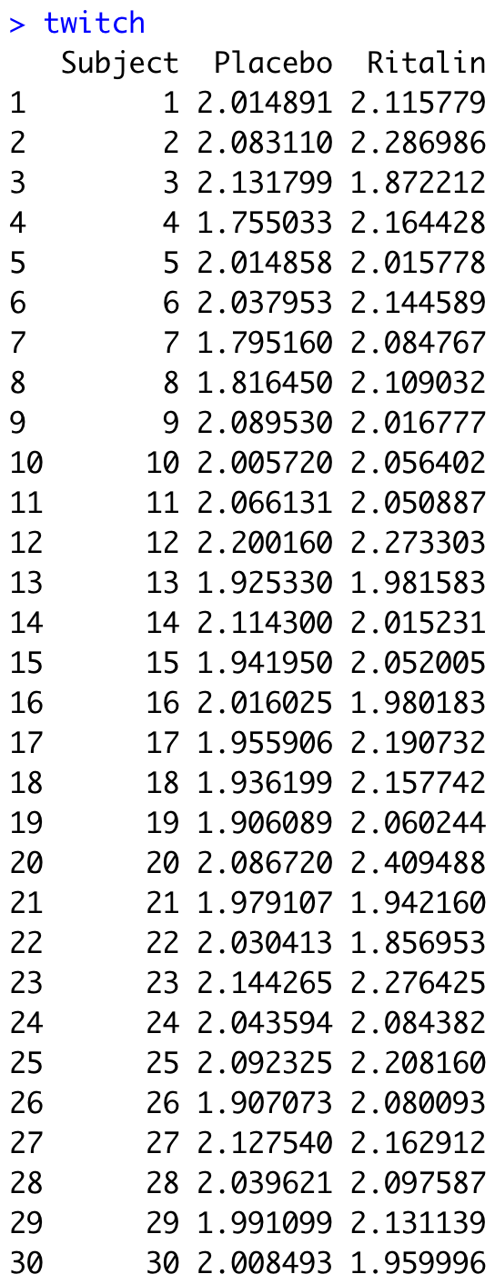
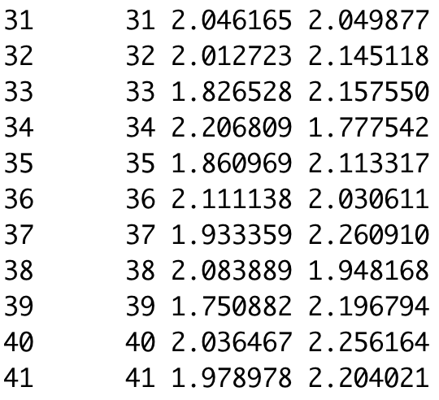
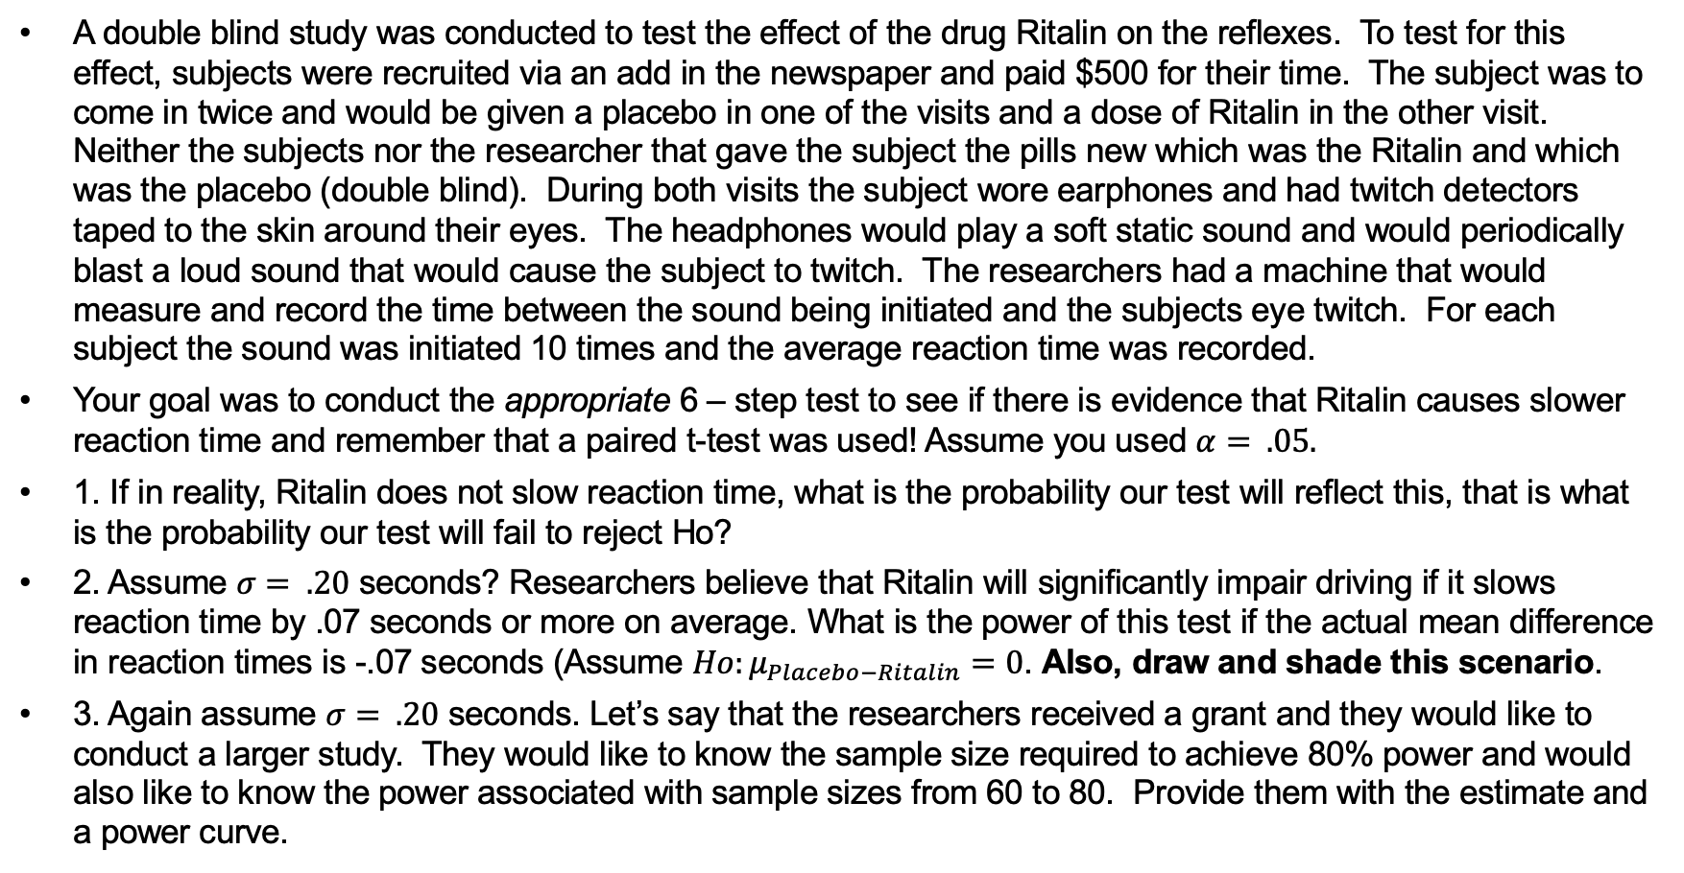
Recall the Reaction Time Experiment!
A double blind study was conducted to test the effect of the drug Ritalin on the reflexes. To test for this effect, subjects were recruited via an add in the newspaper and paid $500 for their time. The subject was to come in twice and would be given a placebo in one of the visits and a dose of Ritalin in the other visit. Neither the subjects nor the researcher that gave the subject the pills new which was the Ritalin and which was the placebo (double blind). During both visits the subject wore earphones and had twitch detectors taped to the skin around their eyes. The headphones would play a soft static sound and would periodically blast a loud sound that would cause the subject to twitch. The researchers had a machine that would measure and record the time between the sound being initiated and the subjects eye twitch. For each subject the sound was initiated 10 times and the average reaction time was recorded.
Your goal was to conduct the appropriate 6 – step test to see if there is evidence that Ritalin causes slower reaction time and remember that a paired t-test was used! Assume you used $α= .05.$
1. If in reality, Ritalin does not slow reaction time, what is the probability our test will reflect this, that is what is the probability our test will fail to reject Ho?
2. Assume $σ= .20$ seconds? Researchers believe that Ritalin will significantly impair driving if it slows reaction time by .07 seconds or more on average. What is the power of this test if the actual mean difference in reaction times is -.07 seconds (Assume $Ho:μ_{Placebo−Ritalin}=0$. Also, draw and shade this scenario.
3. Again assume $σ= .20$ seconds. Let’s say that the researchers received a grant and they would like to conduct a larger study. They would like to know the sample size required to achieve 80% power and would also like to know the power associated with sample sizes from 60 to 80. Provide them with the estimate and a power curve.

Slide 12
End Question 3

Slide 13

Question 4 ($≤2$ hours)

Slide 14
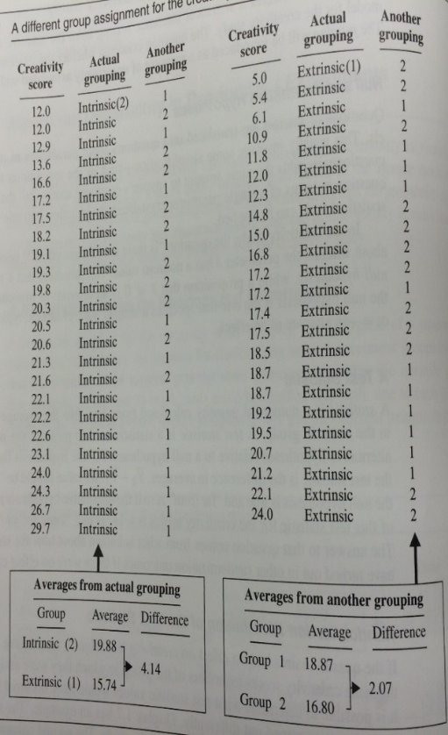
Recall the Creativity Study!
Review the Creativity study we have studied since Unit 1.
1. Assume that a practically significant difference in mean creativity scores is 3 points and thus at this point a University would consider changing their curriculum to either intrinsic or extrinsic type motivation, whichever is more favorable. What is the power of the test that the researchers ran to detect a difference if the true difference in mean creativity scores was exactly 3. You may assume that both the intrinsic and extrinsic standard deviations are 4.5 points.
2. Draw the scenario described above.
3. What does this mean for the power if the true difference in means was greater than 3?
4. Create a power curve to visualize the effect on power if the true difference in mean creativity scores was a value between 3 and 5.

Slide 15
End Question 4

Slide 16
Question 5: Takeaways!
Please provide at least 4 takeaways from this section and any questions that you may have. These questions will help design the live session for this unit.
This question will be the last question of every For Live Session Assignment. The idea is that this deck will serve as a document that you can reference in the future to remember what was covered in this section. For instance, this may come in handy for the Capstone and will hopefully become useful in your career. Most immediately, it may become handy as a quick reference for your Midterm and Final! Some students find it very useful and spend a few slides summarizing the asynch material while others learn different ways and only had the minimum 4 takeaways. Either is fine and will earn you full credit for this question.

Slide 17
Question 6: Questions!
Please provide any question or topics of discussion that came up in this Unit! These will help help us optimize our live session for maximum learning and takeaways!
This question will be the last question of every For Live Session Assignment. The idea is that this deck will serve as a document that you can reference in the future to remember what was covered in this section. For instance, this may come in handy for the Capstone and will hopefully become useful in your career. Most immediately, it may become handy as a quick reference for your Midterm and Final! Some students find it very useful and spend a few slides summarizing the asynch material while others learn different ways and only had the minimum 4 takeaways. Either is fine and will earn you full credit for this question.

Slide 18
Useful Resources
SAS proc Power Info
https://support.sas.com/documentation/onlinedoc/stat/141/power.pdf

Slide 19
End For Live Session Assignment Unit 4!

